Slide 1


Was or Were?
A Simple Past Verb To Be Presentation

Slide 2

Introduction
Hi, students!
Today we’re going to learn how to talk about the past using the verb to be.
You already know how to say things like:
“I am at school.”
“They are my friends.”
But…
What if we want to talk about yesterday or last week?
That’s when we use the past tense: was and were.

Slide 3


Verb To Be
Present
Past
am
was
is
were
are

Slide 4

Affirmative Form
I
you
he
was
we
were
she
they
it

Slide 5
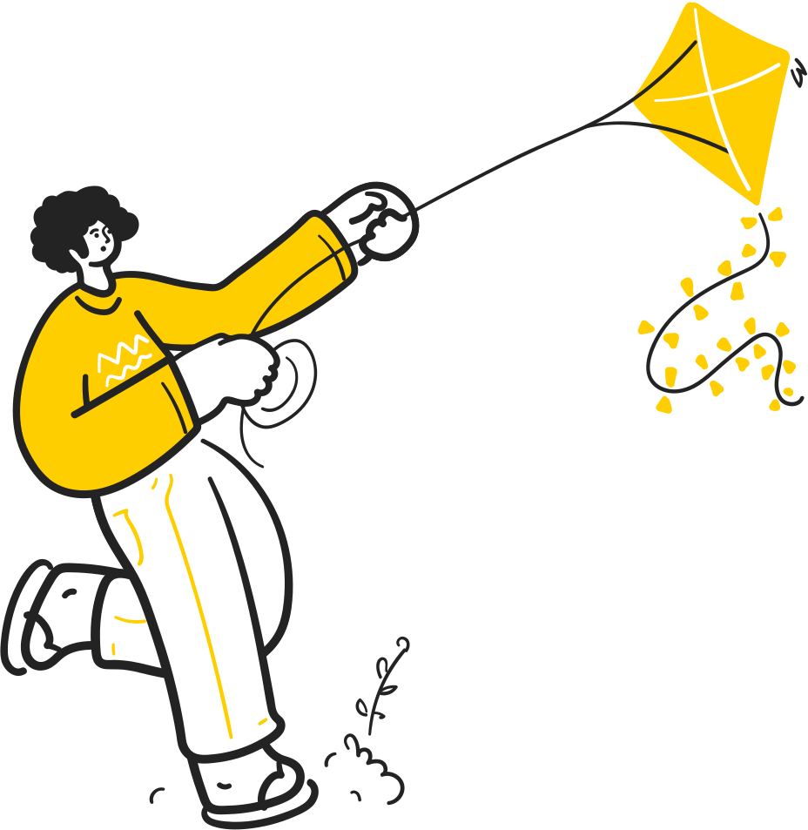
Examples
PRESENT
PAST
I am at school now.
I was at home this morning.
My mum is 44 years old.
My mum was 40 in 2020.
We are in room 2B.
We were in room 2C last year

Slide 6

Negative Form
I
you
he
was not/
we
were not/
she
wasn’t
weren´t
they
it

Slide 7

Examples
I was at home this morning. I wasn’t at school
My mum was 40 in 2020. She wasn’t 42.
We were in room 2C last year. We weren’t in room 2A

Slide 8

Interrogative Form
I
you
he
Was
?
Were
we
?
she
they
it

Slide 9

Examples
Were you at home this morning? No, I wasn’t.
Was Ms. Wilson your teacher last year? Yes, she was.
Were they at the party last Saturday? No, they weren’t

Slide 10

Great Job!

Slide 11


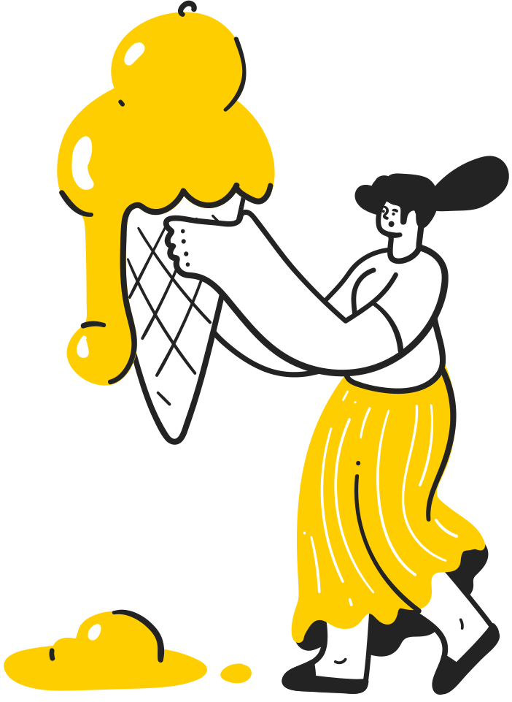








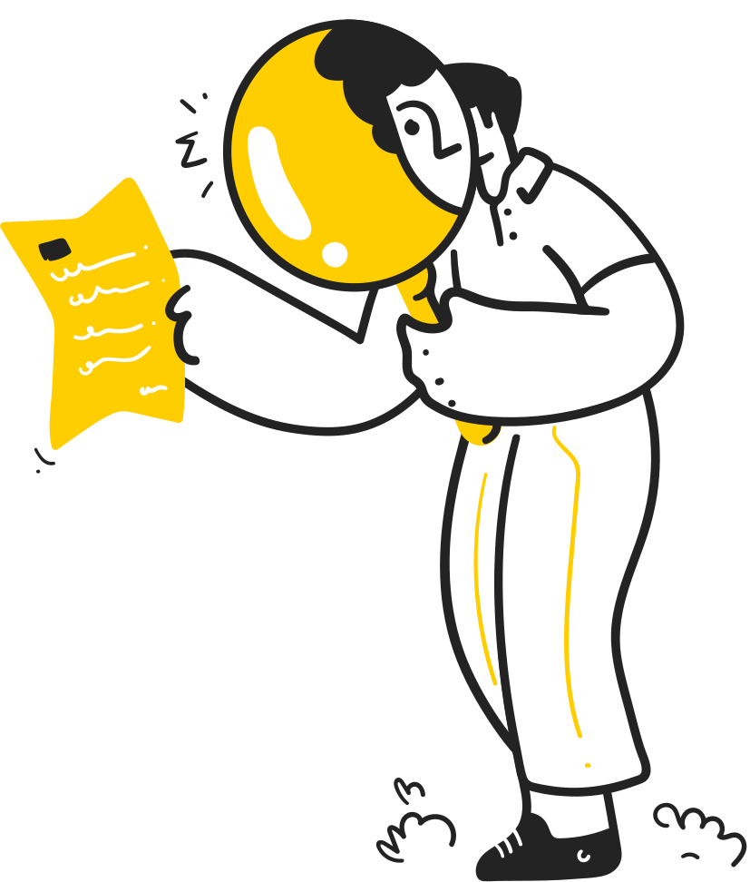
Teacher resources page

